Slide 1
What to expect in employment law in 2026
MFMac Employment Team
15 January 2026

Slide 2
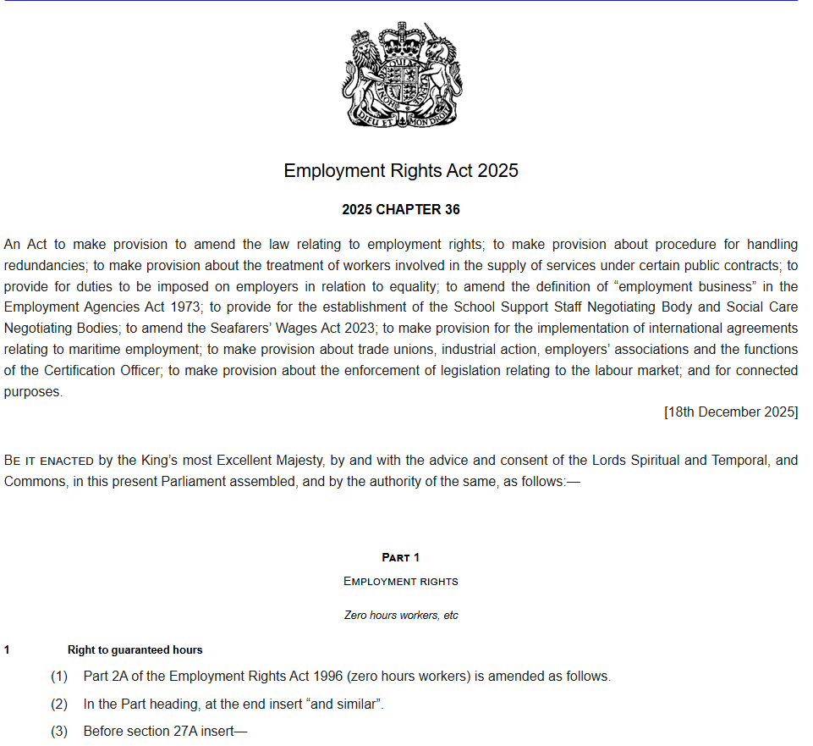
What we will cover
Key Employment Rights Act 2025 changes and how to prioritise
Other changes
Removal of the unfair dismissal compensation cap
Cases to look out for
Employment Tribunal claim trends
Our predictions for 2026
Q&A

Slide 3
Implementation timetable
Date | Action
On Royal Assent or shortly thereafter | Repeal of the Strikes (Minimum Service Levels) Act 2023 Repeal of most of the Trade Union Act 2016 (some provisions will be repealed later via a commencement order) Simplifying industrial action notices and industrial action ballot notices Enhanced protection against dismissal for taking industrial action
Notes:
Just a reminder that the Government published an implementation roadmap back in July. This is a helpful document and sets out the timings for the changes the Bill is going to introduce as well as setting out the dates for various consultations that are due to take place in relation to the changes.
It is subject to change but if you are not already familiar with the Bill and the timings the implementation timetable is the best place to start.
So, with reference to the implementation timetable, over the next 3 slides I’ll highlight the key changes coming into force over the next 12 months.
This first slide deals with changes that will take effect immediately when the Bill comes into force and two months after that date.
The changes on this slide will really only effect unionised employers at this stage. The more significant impact will be felt from April 2026 onwards.
The key points to note here are:-
[SLIDE]
Repeal of Strikes (Minimum Service Levels) Act - this legislation allowed for minimum service levels during strike action in sectors like transport, health, fire and rescue and education. This was never used in practice by any employer but it will be repealed.
The Employment Rights Bill will also repeal most of the Trade Union Act 2016, which means:-
the end of the 50% turnout requirement for industrial action ballots. At the moment, at least 50% of all union members eligible to vote in the particular dispute are required to vote to make the vote valid – the Bill allows for only a simple majority of those who turn out to vote. This was intended to take effect two months after the Bill receives Royal Assent but this particular change is being delayed to align as closely as possible with the introduction of e-balloting which is intended to come into force in April 2026.
The repeal of most of the Trade Union Act will also mean that:-
the required notice period for strikes will reduce from 14 to 10 days
the validity of a strike mandate will increase from 6 to 12 months
the repeal of the Trade Union Act, also simplifies the information required in ballot notices and also removes other administrative barriers to trade union activity
Taken together, this will allow for more freedom for trade unions to organize industrial action and the threshold change will make it more likely that industrial action will take place.
Enhanced protection against dismissal - Dismissal for taking part in industrial action will become 'automatically unfair’. In addition, at present an employee is only protected for the first 12 weeks of strike action. The Bill will remove the current 12-week limit so that the protection is indefinite.
So, some important changes which strengthen the powers of trade unions but, as the slides says, the most significant impact for employers will be felt from April next year and beyond….

Slide 4
Key changes
Enhanced industrial action and TU rights (February 2026)
Protection from unfair dismissal for taking industrial action becomes automatically unfair
Time needed to give notice of industrial action will reduce from 14 to 10 days
Picket supervisors will no longer be required
Industrial action mandates will last for 12 months instead of 6
Industrial action and ballot notices will be simplified
Political fund rules will change

Slide 5
Implementation timetable
Date | Action
April 2026 | Increase in maximum period of collective redundancy protective award Day 1 rights to paternity leave and unpaid parental leave Removal of the lower earnings limit and waiting period for SSP Establishment of the Fair Work Agency Whistleblowing protections Simplifying TU recognition process Electronic and workplace balloting Equality action plans (gender pay gap and menopause) introduced on a voluntary basis
Notes:
Given time constraints I’m not going to spend too much time on the next two slides but rather I just wanted to highlight the shear amount of change that is coming our way in 2026.
So starting with April 2026….
Paternity leave and parental leave will become a day 1 right – so changes will be needed to policy documents
Removal of qualifying days for SSP – possible changes to contracts/policy documents
Doubling of collective redundancy protective award from 90 to 180 days per employee
Simplification of trade union recognition process – this coupled with rights of access/right to join a trade union (October) – we will see increased pressure on employers to recognise trade unions
Equality Action plans – applies only to employers with 250 or more employees. These plans must detail steps for improving gender equality including addressing the gender pay gap and supporting employees though the menopause. This will only be voluntary for April 2026 before becoming mandatory in 2027
Separate legislation is planned for race and disability pay gap reporting but this is still some time away – 2027 or 2028.

Slide 6
Key changes
Redundancy and consultation (April 2026)
Maximum collective redundancy protective award doubles to 180 days’ pay per employee
Family leave and Statutory Sick Pay (April 2026)
Paternity and unpaid parental leave entitlement begins on day 1 of employment
Statutory sick pay entitlement begins on day 1 of employment, and the lower earnings limit no longer applies extending eligibility to all employees

Slide 7
Key changes
Fair work agency (April 2026)
Fair Work Agency will be created, to be headed up by Matthew Taylor
FWA expected to crackdown on failure to pay NMW and holiday pay
Use of umbrella companies to facilitate tax avoidance schemes is expected to be another area of FWA focus
Will take some time to set up and breadth of powers set to expand over the coming years

Slide 8
Key changes
Whistleblowing protection (April 2026)
Sexual harassment disclosures will be explicitly protected as a qualifying disclosure for whistleblowing purposes
Trade union activities (April 2026)
Simplifying TU recognition
Allowing TU members to vote electronically
Equality action plans (April 2026)
Voluntary only at this stage

Slide 9
Other changes - April
National minimum/living wage increases
Statutory benefits increase
Employment Tribunal award increases
Vento bands increase

Slide 10
Implementation timetable
Date | Action
October 2026 | Ban on dismissal and re-engagement Requirement to take all reasonable steps to prevent sexual harassment Requirement to prevent third-party harassment Extension of tribunal time limit from three to six months New rights and protections for TU representatives Duty to inform workers of their right to join a TU Strengthening of TU rights of access to workplaces Tightening tipping laws
Notes:
Turning to October 2026 and again just highlighting some of these changes….
Fire and rehire –this will make it far harder to make changes to terms and conditions of employment and Lindsey will say a bit more about this in a moment
Duty to inform workers of right to join TU and strengthening TU rights of access to workplaces
The Employment Rights Bill provides for a new right to be informed of the right to join a trade union. This right applies whether an employer recognised a trade union or not.
The Bill also establishes a statutory right for unions to access workplaces and to communicate with workers in person and digitally. And again, this right will apply whether an employer recognises a trade union or not.
Requirement to take all reasonable steps to prevent sexual harassment – higher bar than current obligation to take reasonable steps
ET time limit extended from 3 to 6 months – this will likely result in an increase in the number of Employment Tribunal claims raised against employers (1st December of this year – ET conciliation time limits increasing from 6 weeks to 12 weeks)

Slide 11
Key changes
Fire and rehire (October 2026)
Dismissals to impose changes to certain specified contractual terms will be automatically unfair if the reason is the employee did not agree to the variation
Also covers fire and replace scenarios
Limited exception for employers acting in response to financial difficulties affecting their ability to carry on business as a going concern
If fire and rehire is used for contractual changes falling outside the specified categories, the dismissal may still be unfair but will not be automatically unfair

Slide 12
Key changes
Extended harassment duties (October 2026)
Employers must take all reasonable steps to prevent sexual harassment in the workplace
Employers can be liable for third party harassment (e.g. customers)
Tribunal time limits (October 2026)
Time limit for raising tribunal claims increases from 3 to 6 months

Slide 13
Key changes
Trade union activities (October 2026)
Duty to inform workers of their right to join a TU
Updated rules on TU right of access to the workplace
New right for reasonable accommodation and facilities for TU reps carrying out duties
New right to time off for union equality representatives
Increased protection against detriment for industrial action

Slide 14
Other changes – timing tbc
Non-disclosure Agreements
Any provisions preventing a worker from making allegations or disclosures about harassment or discrimination, including the employer’s reaction to those allegations, will be void
Covers harassment/discrimination by employer or fellow workers
Ban may be extended to cover additional categories e.g. independent contractors
Will be “excepted agreements” when ban won’t apply
Timetable for implementation unclear but UK government indicated an intention to introduce swiftly

Slide 15
Priorities for 2026
Keep up to speed with the Implementation Roadmap
Risk assess
Who needs to be told about the changes?
Audit and update contracts as and when required
Which policies need updated?
Are new policies required?

Slide 16
Priorities for 2026
Get ready for new reporting obligations
Identify where training is required
Read and respond to Government consultations
Keep up to date and keep an eye on 2027 changes
Risk assess removal of compensatory awards cap and consider changes to procedures

Slide 17
Removal of unfair dismissal compensation cap
Change will make no difference for most employees who raise a claim
  median annual earnings in UK - around £39,000
  rare for Tribunal to award in excess of 12 months’ pay
  average unfair dismissal award in 2023/24 was £13,749
Will transform approach to “high earner” employee terminations
  significant impact on settlement negotiations
  could be very expensive for businesses with high earning employees
  possible move away from “tap on the shoulder” approach?

Slide 18
Removal of unfair dismissal compensation cap
More unfair dismissal claims from high earners
Tribunal hearings will take longer
Not just high earners - other circumstances also where risk increases
Expected to take effect on either 1 January 2027 or 6 April 2027, following a pre-commencement impact assessment

Slide 19
Cases to look out for
Case | Issue
Augustine v Data Cars Ltd | Supreme Court - whether Part-time Workers (Prevention of Less Favourable Treatment) Regulations apply if worker’s part-time status is an effective cause, but not the sole cause of less favourable treatment
Wicked Vision v Rice | Supreme Court – whether employees can bring whistleblowing detriment claim where the alleged detriment is their dismissal
Miller v University of Bristol | EAT - judgment awaited from the EAT on issues including whether the claimant’s anti-Zionist beliefs were protected philosophical beliefs
Dobson v Cumbria Partnership NHS Foundation Trust | EAT – flexible working dispute – may lead to guidance on how tribunals should approach proportionality in flexible working disputes
Kelly v Leonardo UK Peggie v NHS Fife | EAT – how employers should manage access to workplace toilets/changing facilities where employees’ protected characteristics come into conflict

Slide 20
Employment tribunal trends
Q2 25/26 – 26,000 new Employment Tribunal claims
Q2 25/26 – ET disposed of 10,000 claims
Q2 25/26 – end of the quarter – 515,000 open claims
Significant backlog in England & Wales – less of an issue in Scotland for now…
Significant increase in claims expected in 2027 and beyond:-
  ERA claims
  Time limit increase – 3 to 6 months
  Unfair dismissal qualifying service reduction – 2 years to 6 months
  Removal of unfair dismissal cap

Slide 21
Predictions for 2026
Push by Trade Unions to get greater recognition/possible increase in industrial action
Cases relating to neurodivergence in the workplace and conflicting beliefs will continue to rise
Employers will continue to encounter difficulties in dealing with the consequences of the FWS v The Scottish Ministers judgment
Problems will start to surface in relation to changing terms and conditions of employment
Tribunal claim numbers will continue to increase putting more pressure on the employment tribunal system

Slide 22

Questions

Slide 23
What to expect in employment law in 2026
MFMac Employment Team
15 January 2026

